Slide 1
WHOLESALER RETAILER FOR KURTIS
Group Id: 4
Margi Trivedi (3085)
Mirali Chauhan (3092)
Anjali Parmar (3122)

Slide 2
ADMIN SIDE

Slide 3
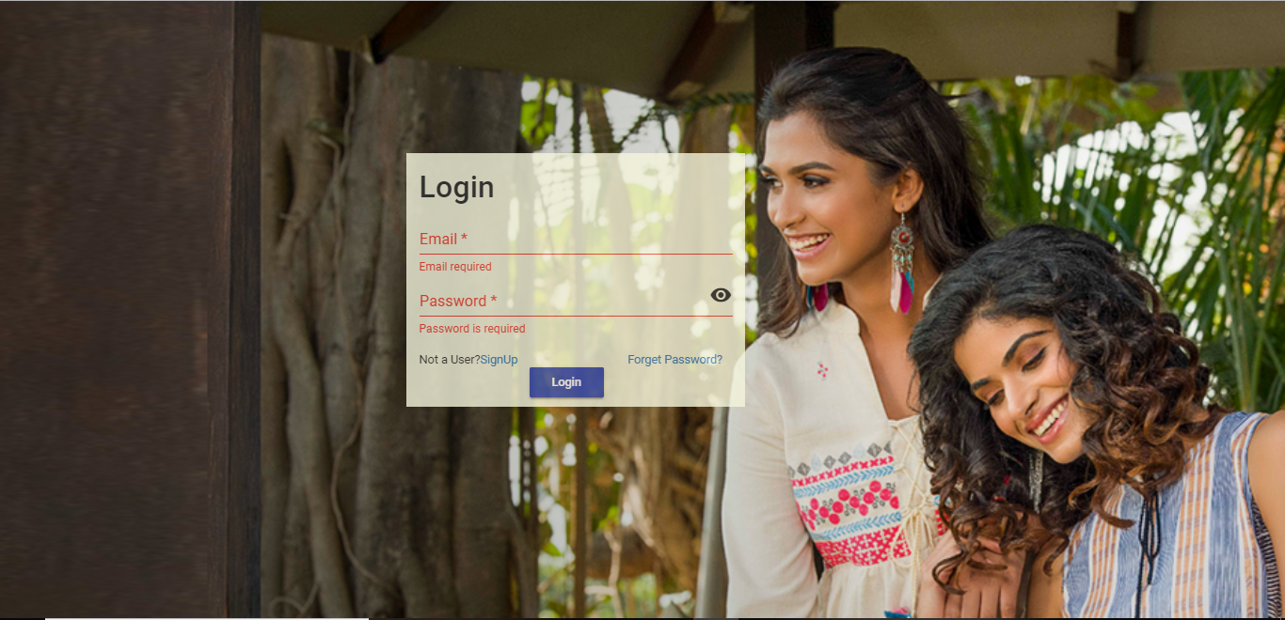
Login: This is the login page of the admin side.In this page email_id and password required.

Slide 4
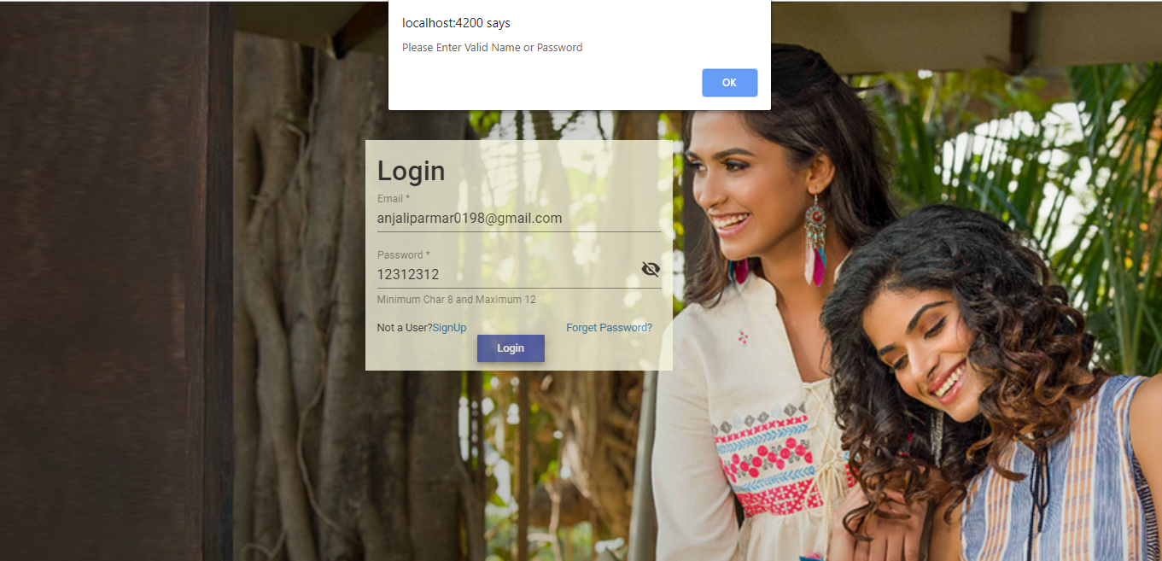
Wrong Password: In this page if the Password is incorrect than it shows alert message.

Slide 5
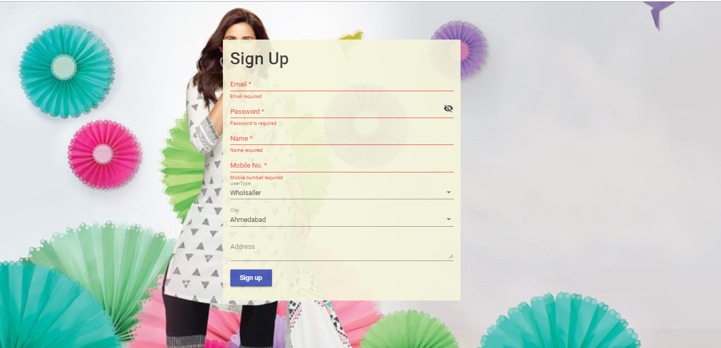
SignUp: This is the signUp Page of the Admin side. In this page all entries are required.

Slide 6
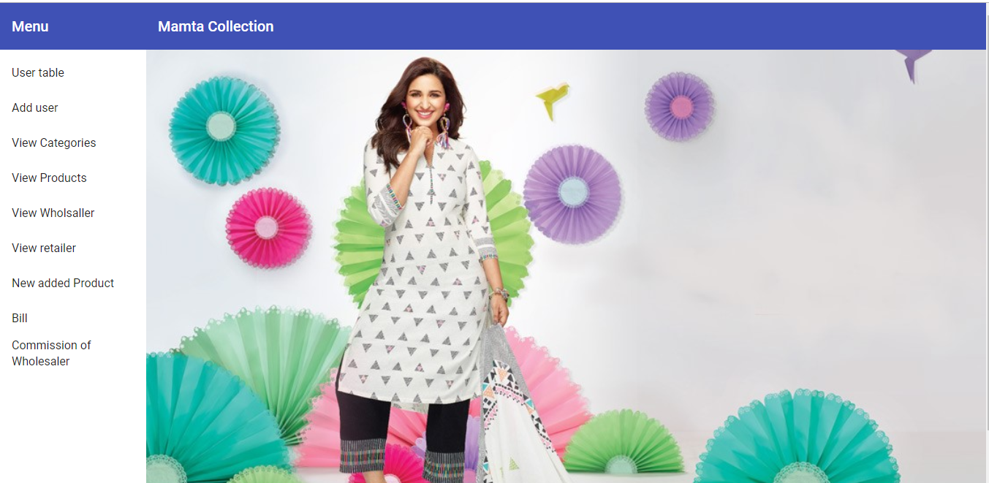
First Page After Login: This is the first page After Login page.

Slide 7
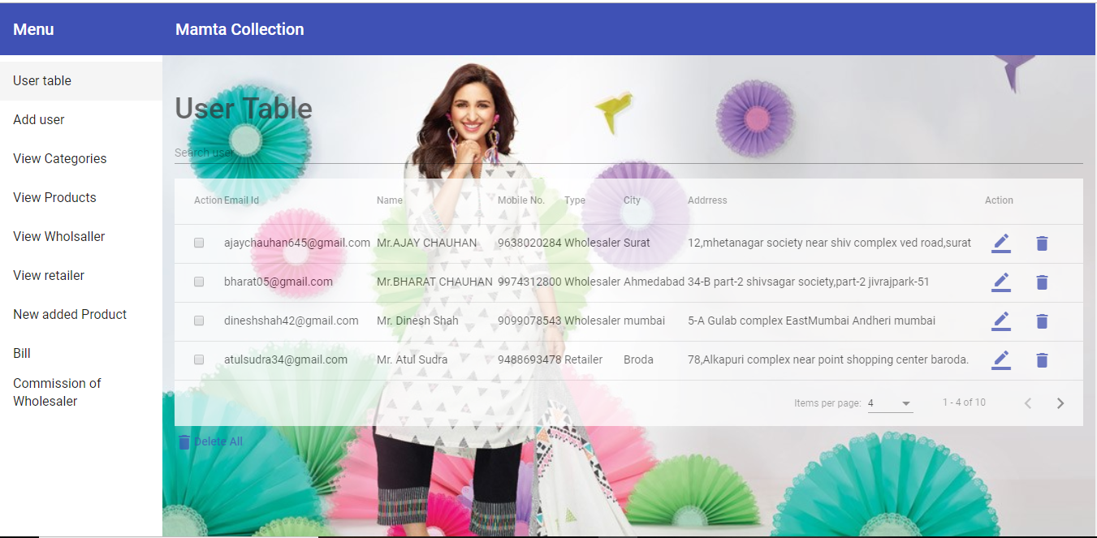
User Table: This is the UserTable page. In this page it shows users in the UserTable.

Slide 8
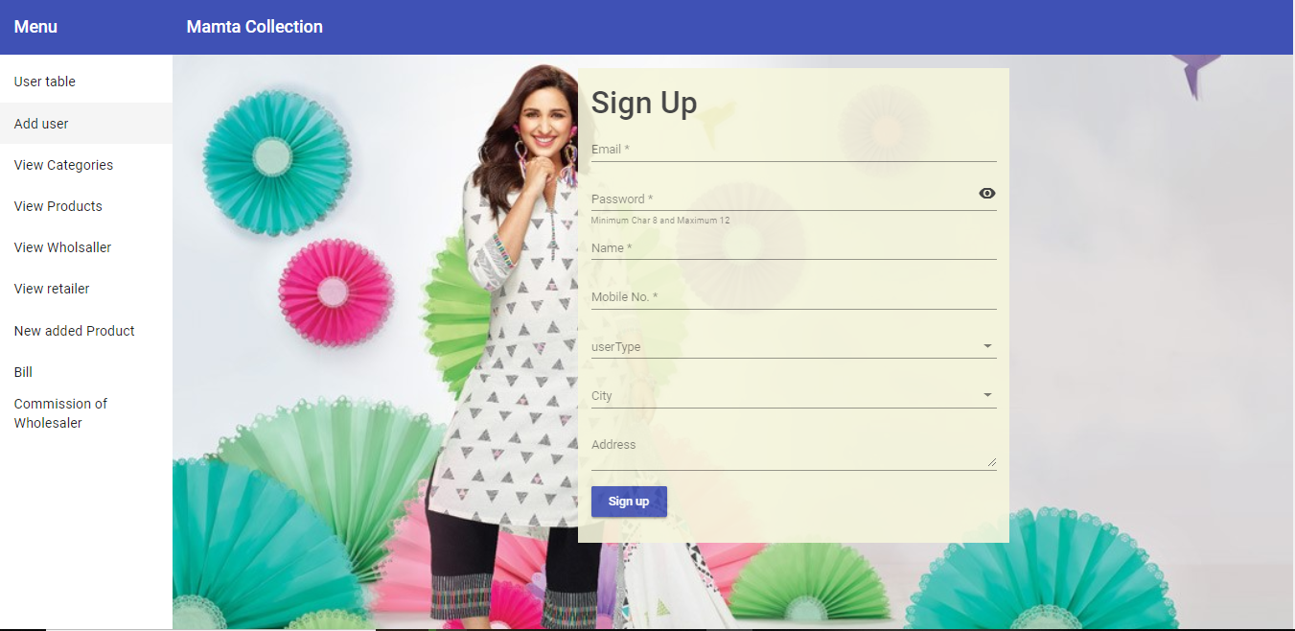
Add User: This is the Add User Page. By this page user can easily signup the form.

Slide 9
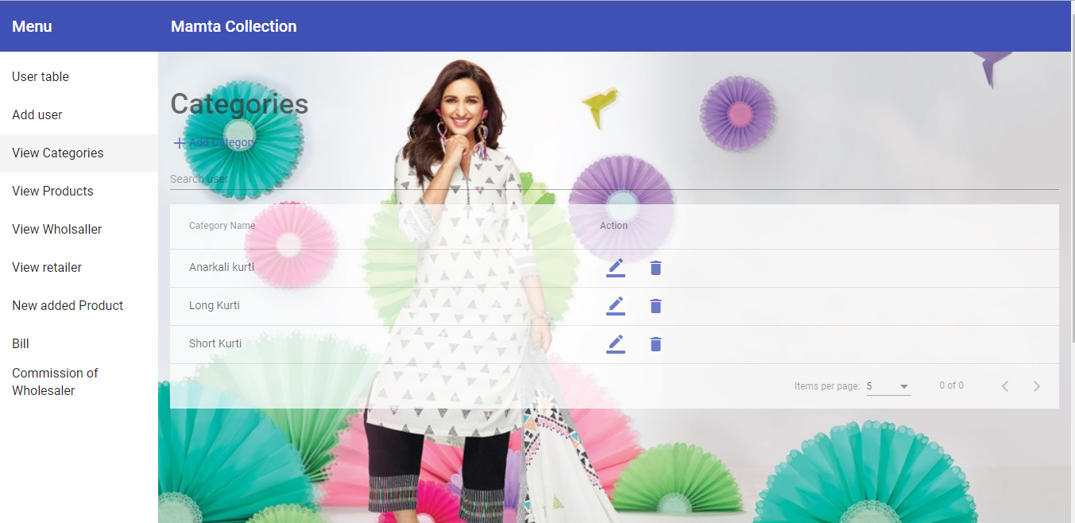
View Categories: This page shows categories of the products.

Slide 10
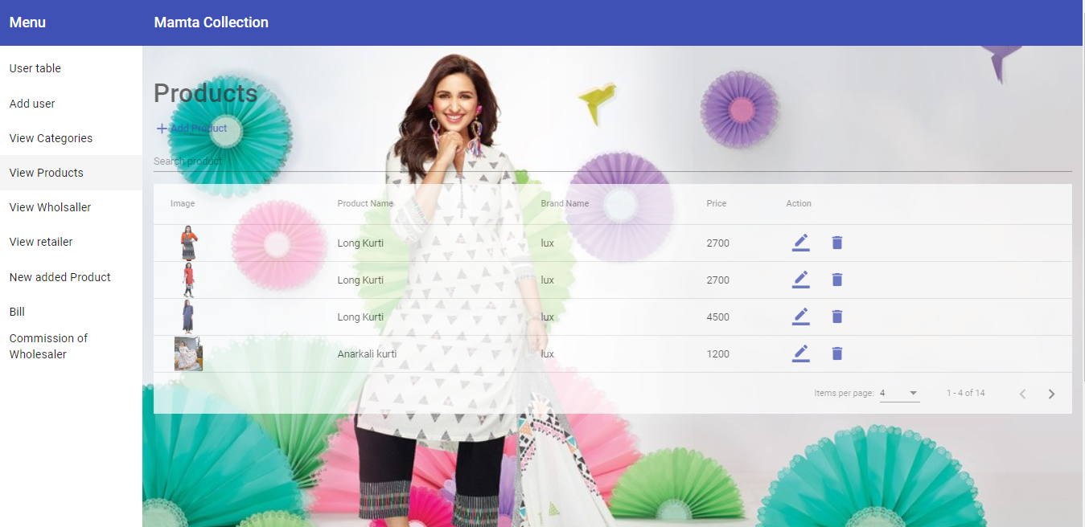
Products: This page shows the products in the categories.

Slide 11
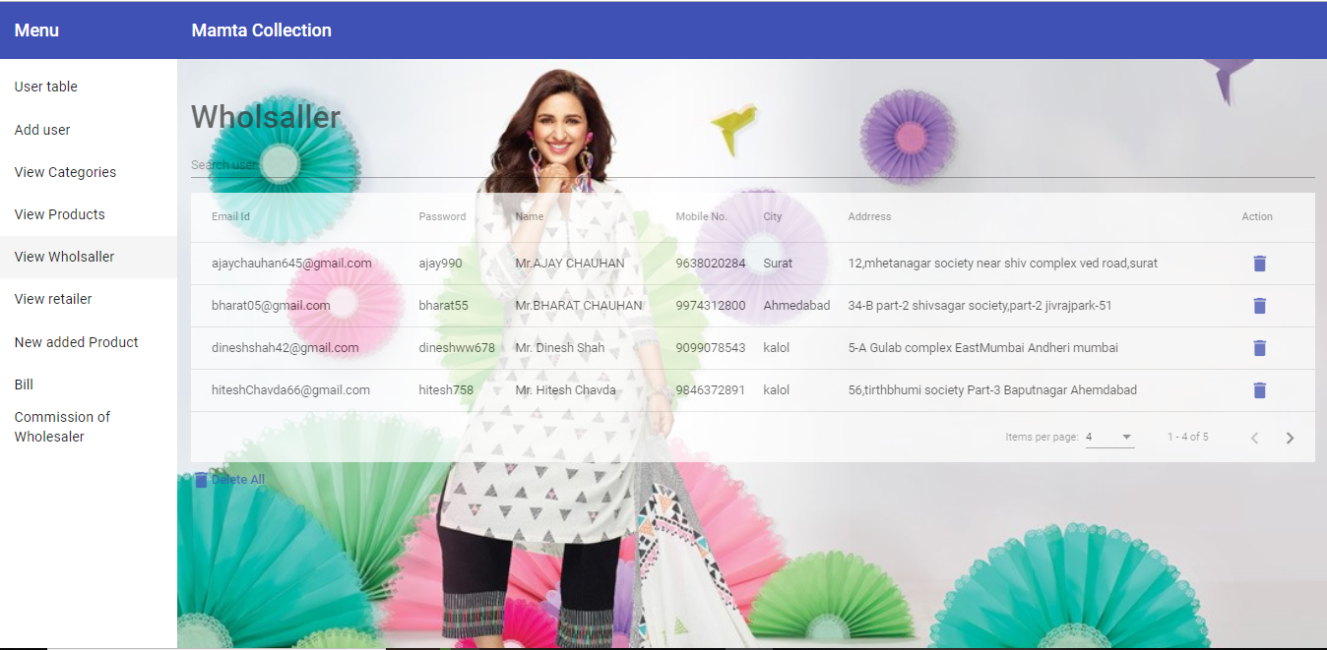
View wholesaler: This page shows list of wholesaler.

Slide 12
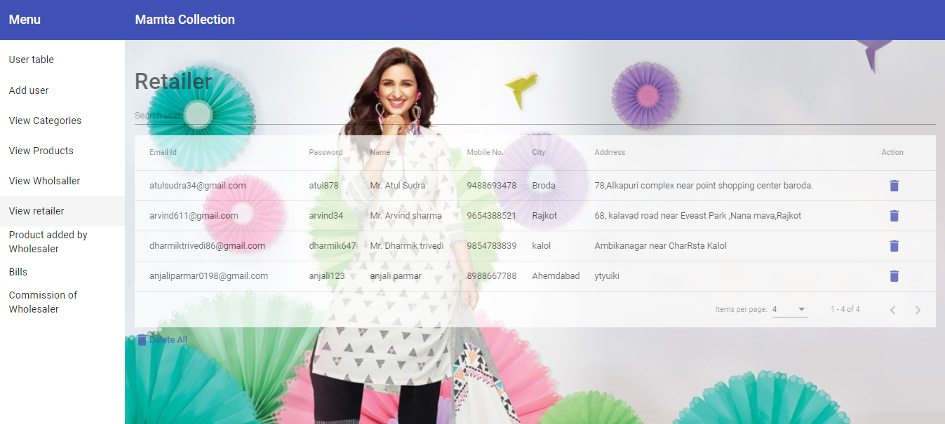
View Retailer: This page shows the retailers records.

Slide 13
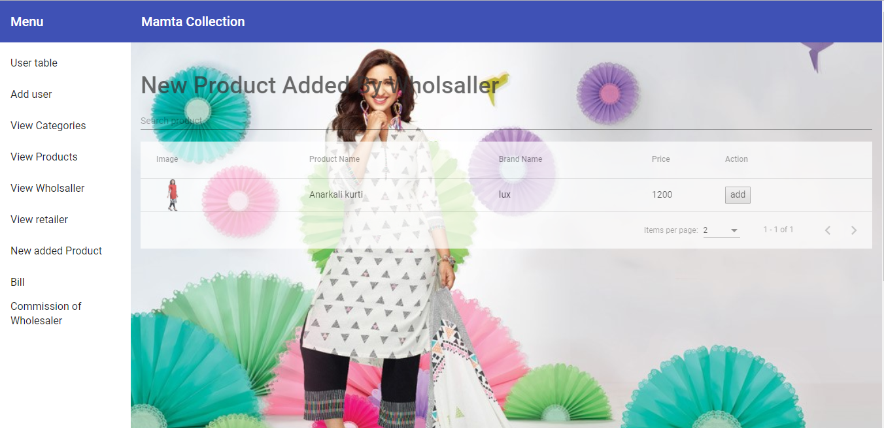
New product added by wholesaler: This page shows new products which are added by wholesaler.

Slide 14
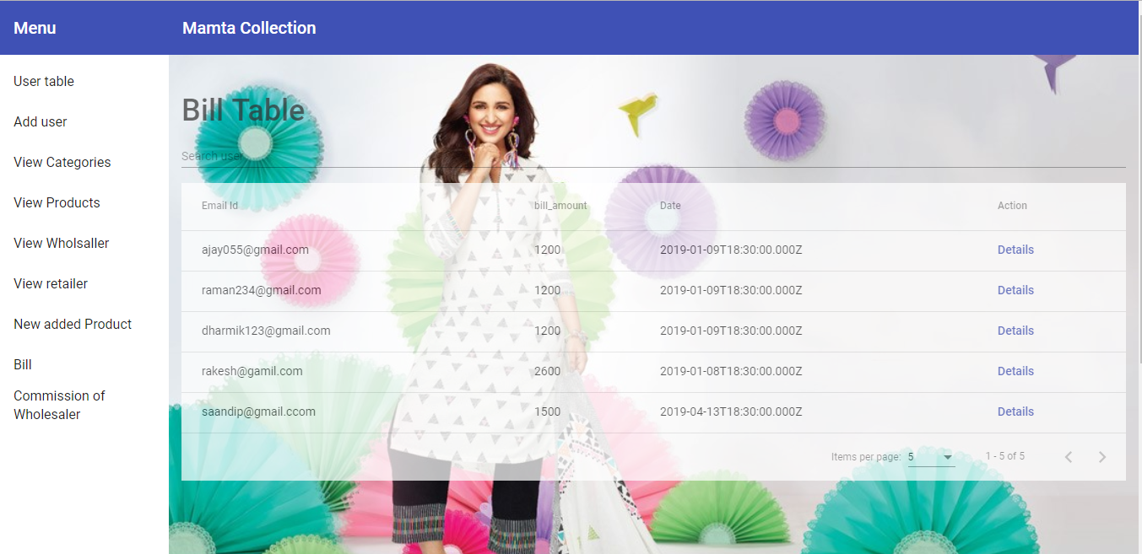
Bill Table: This is bill table of Admin side.

Slide 16
WHOLESALER SIDE

Slide 17
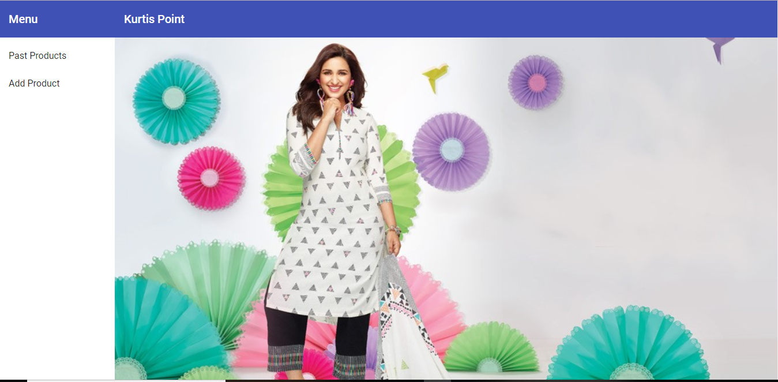
First Page: This is the first page of wholesaler side after the signup or login.

Slide 18
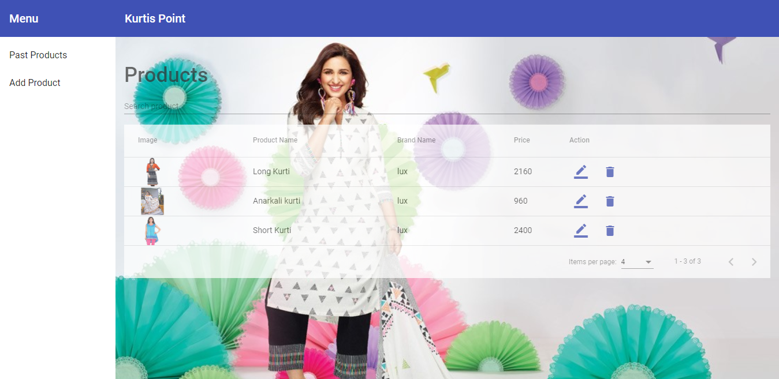
Past Products: This the past products of the wholesalers.

Slide 19
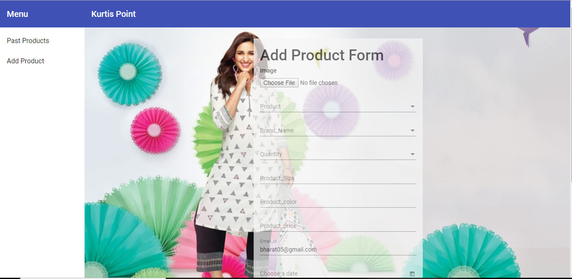
Add Products: This is the add product form of the wholesaler side.

Slide 20
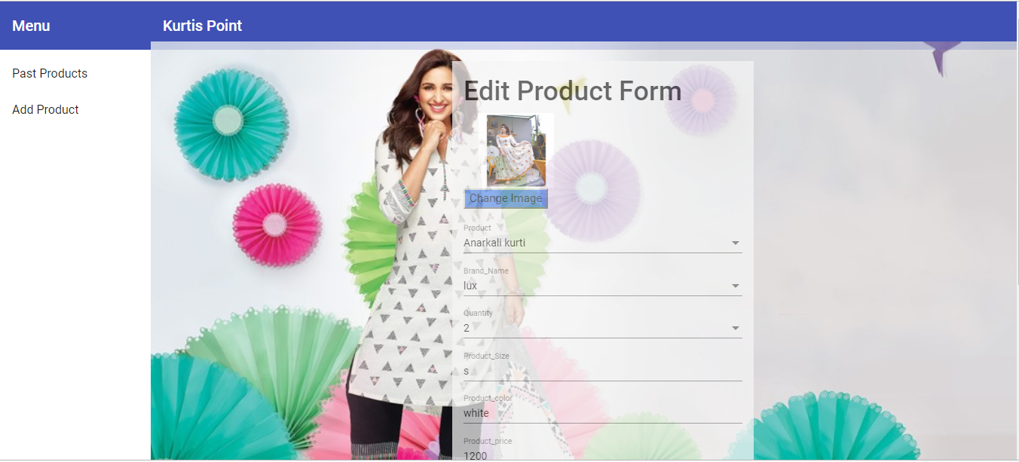
Edit product form: This is the edit product page.

Slide 21
RETAILER SIDE:

Slide 22
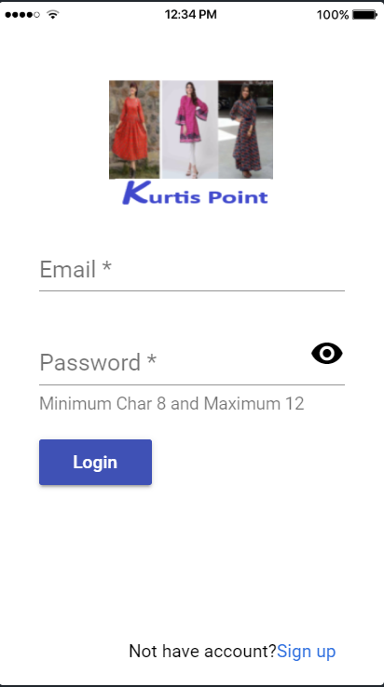
Login: This is the Login page of wholesaler side.

Slide 23
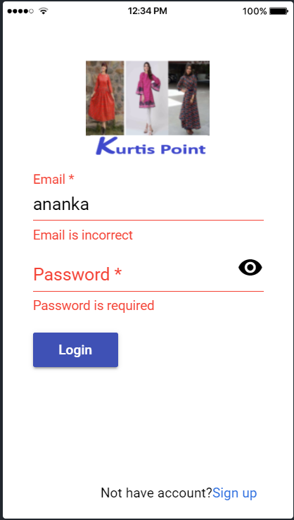
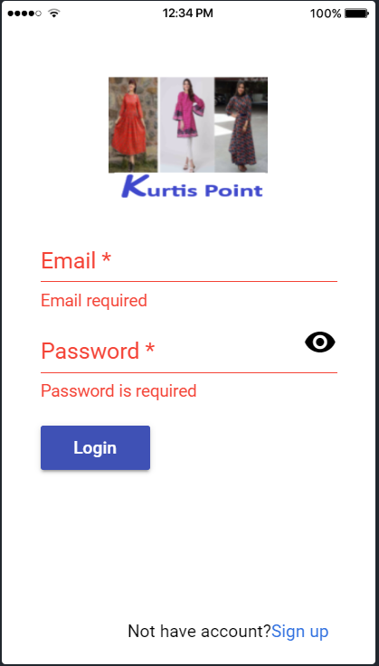
Login_Validation: This is the login page of retailer side.In following figures :- 1. It shows incorrect email error. 2.It shows both email and password are required.

Slide 24
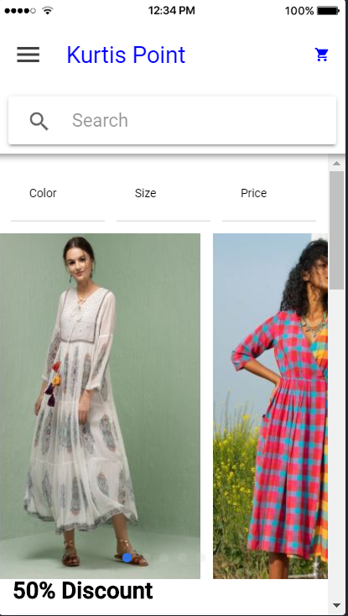
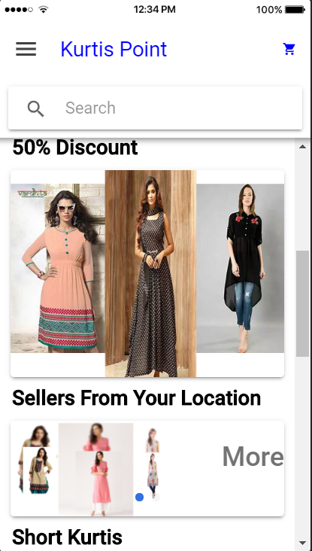
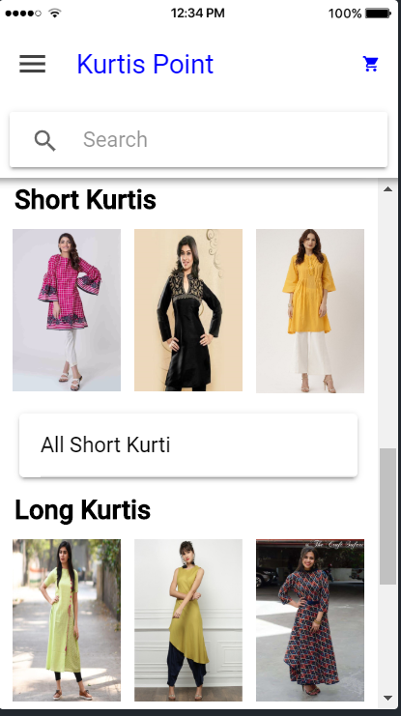
Home Page: This is the home page after the login.

Slide 25
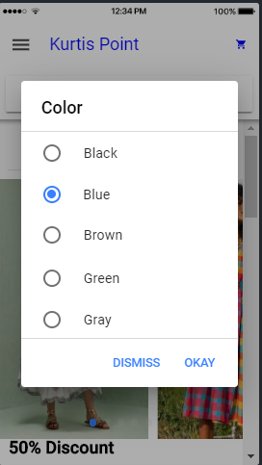
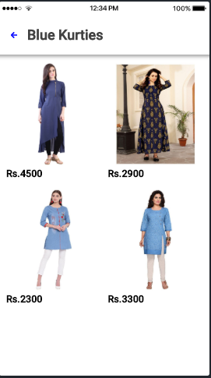
Color Page: The Filter is done on basis of color.Similaraily Filter is done for Size and price.

Slide 26
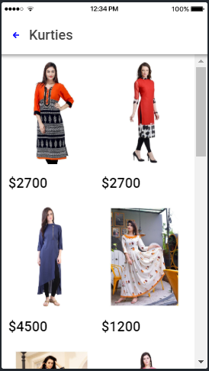
Listing Kurties: This page shows all kurtis.

Slide 27
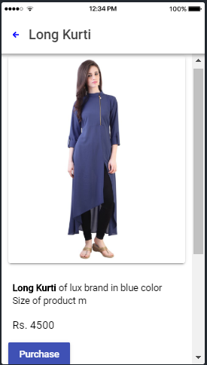
Particular Kurties: This page shows all Particular Kurties.

Slide 28
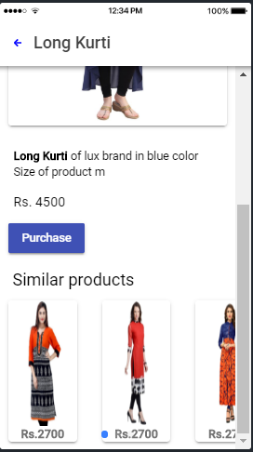
Similar Kurties: This Page shows Similar kurties basis of Particular Kurties.

Slide 29
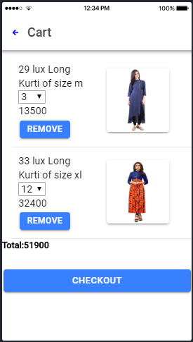
Cart Page: This Page shows bill on cart page. And it shows total bill amount.

Slide 30
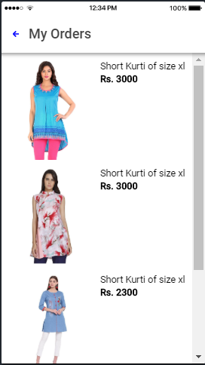
Order Page: This Page Page shows orders which is of retailer orders.

Slide 31
Thank you.

